Slide 1
Introduction to Mathematical Foundation
Dr. Bhakti Palkar

Slide 2

Content
Introduction to R Programming Language
Introduction to the mathematical foundations required for data science. Linear algebra, Matrices, Statistical Inference: Populations and samples, Statistical modeling, Probability distribution, Fitting a model.

Slide 3
What does a matrix look like?
Matrices are everywhere. If you have used a spreadsheet such as Excel or Lotus or written a table, you have used a matrix. Matrices make presentation of numbers clearer and make calculations easier to program.
Look at the matrix below about the sale of tires in a store – given by quarter and make of tires.
Q1 Q2 Q3 Q4
If one wants to know how many Copper tires were sold in Quarter 4, we go along the row Copper and column Q4 and find that it is 27.

Slide 4
What is a matrix?
A matrix is a rectangular array of elements. The elements can be symbolic expressions or numbers. Matrix [A] is denoted by
Row i of [A] has n elements and is
and column j of [A] has m elements and is
The matrix [A] may also be denoted by [A]_{mxn} to show that [A] is a matrix with m rows and n columns.
Each entry in the matrix is called the entry or element of the matrix and is denoted by a_{ij} where I is the row number and j is the column number of the element.

Slide 5
What is a matrix?
The matrix for the tire sales example could be denoted by the matrix [A] as
There are 3 rows and 4 columns, so the size of the matrix is 3×4. In the above [A] matrix, a₃₄ =27.

Slide 6
Special Types of Matrices
Row Vector
Column Vector
Submatrix
Square Matrix
Upper Triangular Matrix
Lower Triangular Matrix
Diagonal Matrix
Identity Matrix
Zero Matrix
Tri-diagonal Matrices
Diagonally Dominant Matrix

Slide 7
What Is a Vector?
What is a vector?
A vector is a matrix that has only one row or one column. There are two types of vectors – row vectors and column vectors.
Row Vector:
If a matrix [B] has one row, it is called a row vector
and n is the dimension of the row vector.
Column vector:
If a matrix [C] has one column, it is called a column vector
and m is the dimension of the vector.

Slide 8
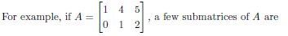
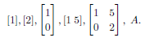
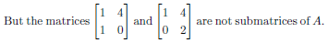
Submatrix
A matrix obtained by deleting some of the rows and/or columns of a matrix is said to be a submatrix of the given matrix.

Slide 9
Square Matrix
If the number of rows m of a matrix is equal to the number of columns n of a matrix [A], (m=n), then [A] is called a square matrix. The entries a₁₁,a₂₂,…, a_{nn} are called the diagonal elements of a square matrix. Sometimes the diagonal of the matrix is also called the principal or main of the matrix.
is a square matrix as it has the same number of rows and columns, that is, 3. The diagonal elements of [A] are (25,10,7) .

Slide 10
Upper Triangular Matrix
is called an upper triangular matrix. That is, all the elements below the diagonal entries are zero.
A m×n matrix for which
Example 5
Give an example of an upper triangular matrix.
is an upper triangular matrix.

Slide 11
Lower Triangular Matrix
is called an lower triangular matrix. That is, all the elements above the diagonal entries are zero.
A m×n matrix for which
Example 6
Give an example of a lower triangular matrix.
is a lower triangular matrix.

Slide 12
Diagonal Matrix
A square matrix with all non-diagonal elements equal to zero is called a diagonal matrix, that is, only the diagonal entries of the square matrix can be non-zero, .
An example of a diagonal matrix.
Any or all the diagonal entries of a diagonal matrix can be zero.

Slide 13
Identity Matrix
A diagonal matrix with all diagonal elements equal to one is called an identity matrix, ( and for all i).
An example of an identity matrix is,

Slide 14
Zero Matrix
A matrix whose all entries are zero is called a zero matrix, ( for all i and j).
Some examples of zero matrices are,

Slide 15
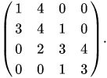
Tridiagonal Matrix
Tridiagonal matrices are the matrices which are having non-zero elements on the diagonal, super diagonal and subdiagonal. All the rest of the elements are zeros.
An example of a tridiagonal matrix is,

Slide 16
Non-square Matrix
Do non-square matrices have diagonal entries?
Yes, for a m×n matrix [A], the diagonal entries are where k=min{m,n}.
What are the diagonal entries of
The diagonal elements of [A] are

Slide 17
Diagonally Dominant Matrix
A n×n square matrix [A] is a diagonally dominant matrix if
for all
and
for at least one i,
that is, for each row, the absolute value of the diagonal element is greater than or equal to the sum of the absolute values of the rest of the elements of that row, and that the inequality is strictly greater than for at least one row. Diagonally dominant matrices are important in ensuring convergence in iterative schemes of solving simultaneous linear equations.

Slide 18
Diagonally Dominant Matrix
Example:
is a diagonally dominant matrix as
and for at least one row, that is Rows 1 and 3 in this case, the inequality is a strictly greater than inequality.

Slide 19
Diagonally Dominant Matrix
is a diagonally dominant matrix as
The inequalities are satisfied for all rows and it is satisfied strictly greater than for at least one row (in this case it is Row 3).

Slide 20
Diagonally Dominant Matrix
is not diagonally dominant as

Slide 21
Equal Matrices
When are two matrices considered to be equal?
Two matrices [A] and [B] is the same (number of rows and columns are same for [A] and [B]) and a_{ij}=b_{ij} for all i and j.
What would make
to be equal to
The two matrices [A] and [B] would be equal if b₁₁=2 and b₂₂=7.

Slide 22
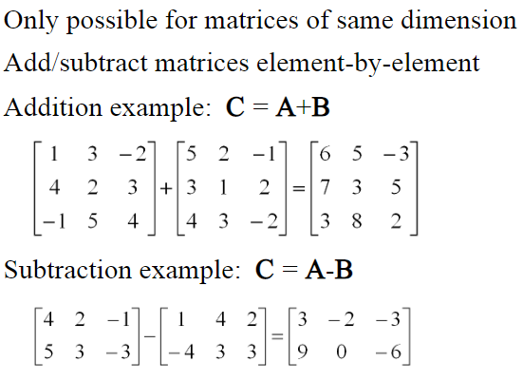
Matrix Addition and Subtraction

Slide 23
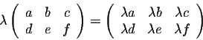
Scalar multiplication
Scalar x matrix = scalar multiplication
Linear Algebra & Matrices, MfD 2009

Slide 24
Matrix Multiplication
“When A is a mxn matrix & B is a kxl matrix, AB is only possible if n=k. The result will be an mxl matrix”
n
l
A₁ A₂ A₃
A₄ A₅ A₆
A₇ A₈ A₉
A₁₀ A₁₁ A₁₂
B₁₃ B₁₄
B₁₅ B₁₆
B₁₇ B₁₈
m
x
k
= m x l matrix
Number of columns in A = Number of rows in B
Linear Algebra & Matrices, MfD 2009

Slide 25
Matrix multiplication
Sum over product of respective rows and columns
X
=
Define output matrix
A
B
=
=
Linear Algebra & Matrices, MfD 2009

Slide 26
Matrix multiplication
Matrix multiplication is NOT commutative
AB≠BA
Matrix multiplication IS associative
A(BC)=(AB)C
Matrix multiplication IS distributive
A(B+C)=AB+AC
(A+B)C=AC+BC
Linear Algebra & Matrices, MfD 2009

Slide 27
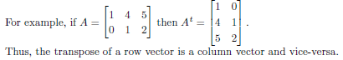
Transpose of Matrix
The transpose of an m × n matrix A, we mean a matrix of order n × m having the rows of A as its columns and the columns of A as its rows.
For any matrix A, we have

Slide 28
Vector Products
Two vectors:
Inner product X^{T}Y is a scalar
(1xn) (nx1)
Inner product = scalar
Outer product = matrix
Outer product XY^{T} is a matrix
(nx1) (1xn)
Linear Algebra & Matrices, MfD 2009

Slide 29
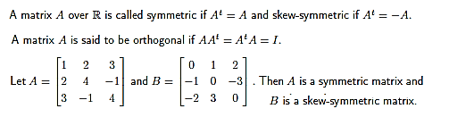
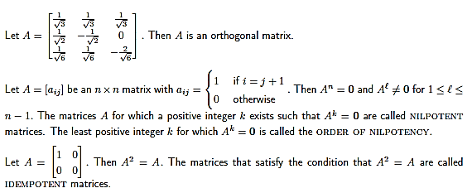
Some More Special Matrices

Slide 30
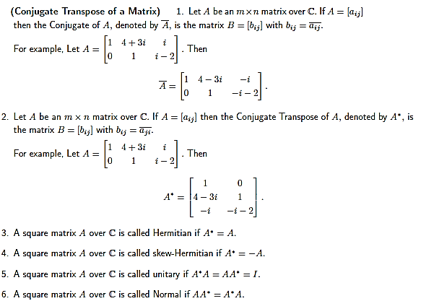
Matrices over Complex Numbers

Slide 31
Determinants
Determinants are mathematical objects that are very useful in the analysis and solution of systems of linear equations (i.e. GLMs).
The determinant is a function that associates a scalar det(A) to every square matrix A.
Input is nxn matrix
Output is a single number (real or complex) called the determinant
Linear Algebra & Matrices, MfD 2009

Slide 32
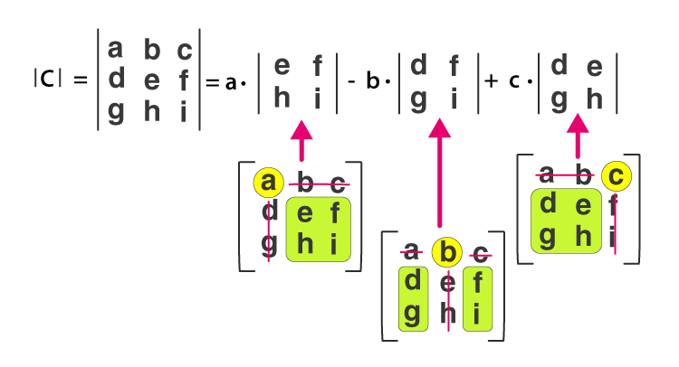
Determinants
Determinants can only be found for square matrices.
For a 2x2 matrix A, det(A) = ad-bc. Lets have at closer look at that:
[ ]
det(A) =
a b
c d
= ad - bc
Determinant of a 3 x 3 Matrix Formula
Linear Algera & Matrices, MfD 2009

Slide 33
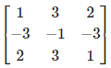
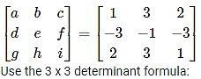
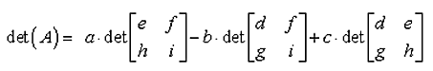
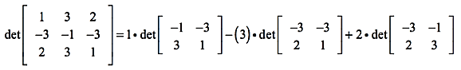
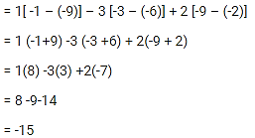
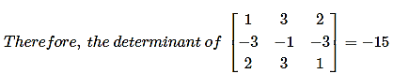
Determinants
Calculate the determinant of the 3 x 3 matrix.

Slide 34
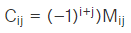
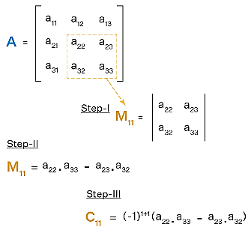
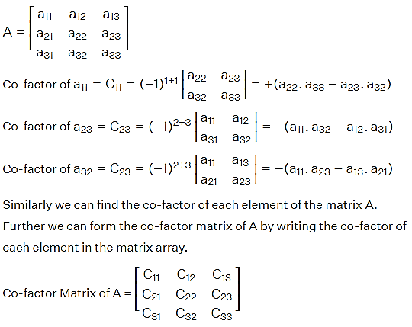
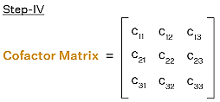
Cofactor Matrix
Co-factor matrix is a matrix having the co-factors as the elements of the matrix.
Co-factor of an element within the matrix is obtained when the minor Mij of the element is multiplied with (-1)^{i+j}.

Slide 35
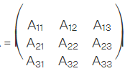
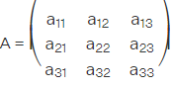
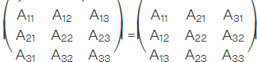
Adjoint of the matrix
The adjoint of a 3 x 3 matrix can be obtained by following two simple steps.
Find the co-factor matrix of the given matrix.
Transpose of this co-factor matrix
the co-factor matrix A

Slide 36
Inverse of Matrix
Definition. A matrix A is called nonsingular or invertible if there exists a matrix B such that:
1 | 1 | X | 2/3 | -1/3 | = | 2/3 + 1/3 | -1/3 +1/3 | = | 1 | 0
-1 | 2 |  | 1/3 | 1/3 |  | -2/3 + 2/3 | 1 + 2 3 3 |  | 0 | 1
Notation. A common notation for the inverse of a matrix A is A⁻¹. So:
The inverse matrix is unique when it exists. So if A is invertible, then A⁻¹ is also invertible and then (A^{T})⁻¹ = (A⁻¹)^{T}
Matrix division: A/B= A*B⁻¹
Linear Algebra & Matrices, MfD 2009

Slide 37
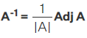
Inverse of Matrix
The inverse of matrix A can be computed using the inverse of matrix formula, by dividing the adjoint of a matrix by the determinant of the matrix. The inverse of a matrix can be calculated by following the given steps:
Step 1: Calculate the minors of all elements of A.
Step 2: Then compute the cofactors of all elements and write the cofactor matrix by replacing the elements of A by their corresponding cofactors.
Step 3: Find the adjoint of A (written as adj A) by taking the tranpose of cofactor matrix of A.
Step 4: Multiply adj A by reciprocal of determinant.

Slide 38
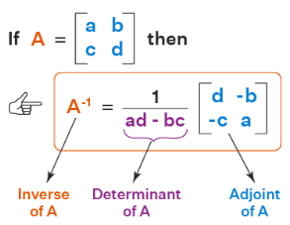
Inverse of Matrix

Slide 39
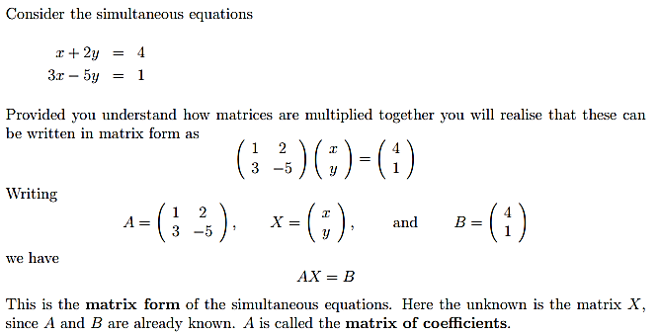
Using the inverse matrix to solve equations
1. Writing simultaneous equations in matrix form

Slide 40
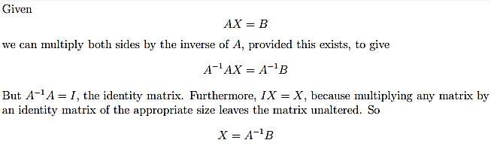
Using the inverse matrix to solve equations
2. Solving the simultaneous equations

Slide 41
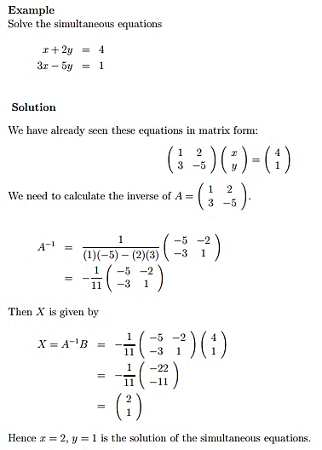
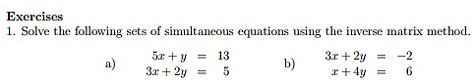
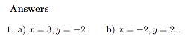

Slide 42
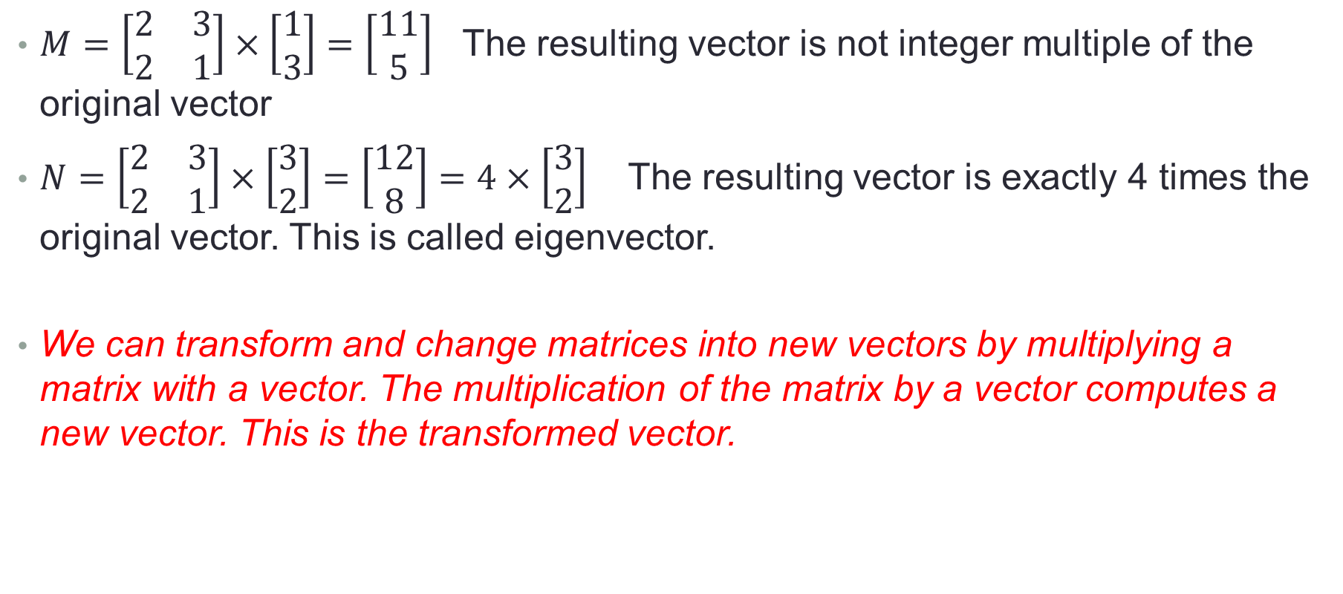
Eigen vectors
$M=\left[\begin{matrix}2 & 3 \\ 2 & 1\end{matrix}\right]×\left[\begin{matrix}1 \\ 3\end{matrix}\right]=\left[\begin{matrix}11 \\ 5\end{matrix}\right]$ The resulting vector is not integer multiple of the original vector
$N=\left[\begin{matrix}2 & 3 \\ 2 & 1\end{matrix}\right]×\left[\begin{matrix}3 \\ 2\end{matrix}\right]=\left[\begin{matrix}12 \\ 8\end{matrix}\right]=4×\left[\begin{matrix}3 \\ 2\end{matrix}\right]$ The resulting vector is exactly 4 times the original vector. This is called eigenvector.
We can transform and change matrices into new vectors by multiplying a matrix with a vector. The multiplication of the matrix by a vector computes a new vector. This is the transformed vector.

Slide 43
Eigenvector
If the new transformed vector is just a scaled form of the original vector then the original vector is known to be an eigenvector of the original matrix
An eigenvector is a vector that does not change when a transformation is applied to it, except that it becomes a scaled version of the original vector.
Eigenvalue— The scalar that is used to transform (stretch) an Eigenvector.

Slide 44

Eigenvector and Eigenvalue
An eigenvector does not change direction in a transformation:
In this shear mapping the red arrow changes direction, but the blue arrow does not. The blue arrow is an eigenvector of this shear mapping because it does not change direction, and since its length is unchanged, its eigenvalue is 1.
1 means no change,
2 means doubling in length,
−1 means pointing backwards along the eigenvalue's direction

Slide 45
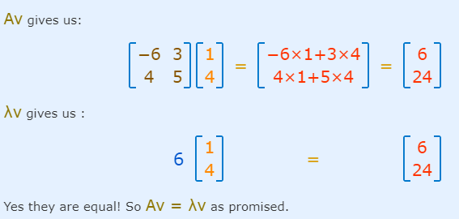
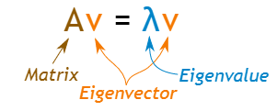
The Mathematics
For a square matrix A, an Eigenvector and Eigenvalue make this equation true:

Slide 46
How do we find these eigen things?
We start by finding the eigenvalue:
we know this equation must be true: Av = λv
Now let us put in an identity matrix so we are dealing with matrix-vs-matrix:
Av = λIv
Bring all to left hand side:
Av − λIv = 0
If v is non-zero then we can solve for λ using just the determinant:
| A − λI | = 0
Let's try that equation on our previous example:

Slide 47
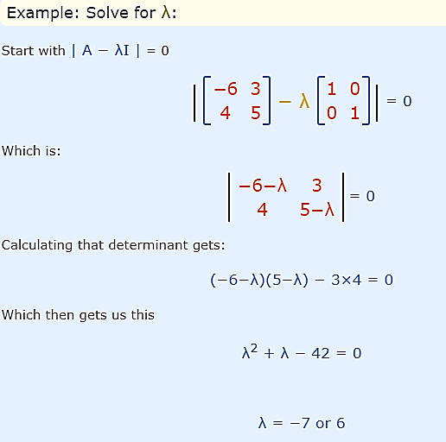
Eigenvector and Eigenvalue

Slide 48
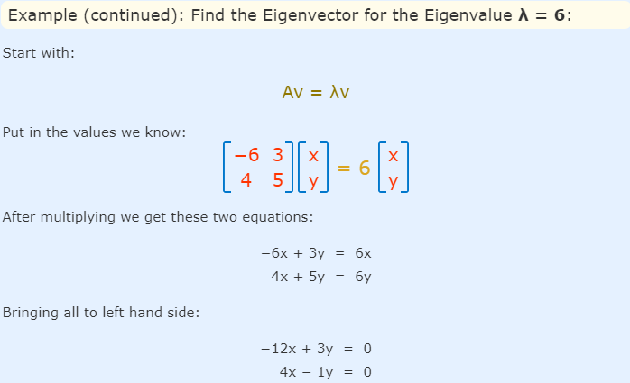
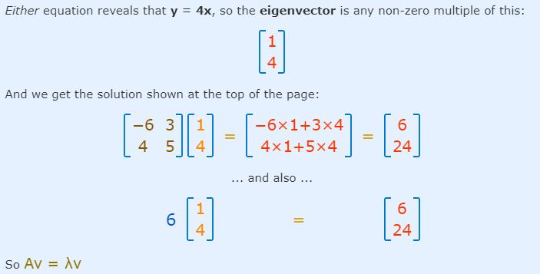

Slide 49
Example 1
find the eigenvalues of the matrix
Solution

Slide 50
Example 1 (cont.)
So the eigenvalues are 3.421 and 0.3288.

Slide 51
Example 2
Find the eigenvectors of
Solution
The eigenvalues have already been found in Example 1 as
Let
be the eigenvector corresponding to

Slide 52
Example 2 (cont.)
Hence
If
then

Slide 53
Example 2 (cont.)
The eigenvector corresponding to then is,
The eigenvector corresponding to is
Similarly, the eigenvector corresponding to is

Slide 54
Eigen vector and Eigen value

Slide 55
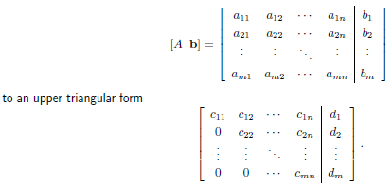
Naïve Gaussian Elimination
Gaussian elimination is a method of solving a linear system Ax = b (consisting of m equations in n unknowns) by bringing the augmented matrix
Two steps
1. Forward Elimination
2. Back Substitution

Slide 56
Forward Elimination
The goal of forward elimination is to transform the coefficient matrix into an upper triangular matrix

Slide 57
Forward Elimination
A set of n equations and n unknowns
. .
. .
. .
(n-1) steps of forward elimination

Slide 58
Forward Elimination
Step 1
For Equation 2, divide Equation 1 by and multiply by .

Slide 59
Forward Elimination
Subtract the result from Equation 2.
−
_________________________________________________
or

Slide 60
Forward Elimination
Repeat this procedure for the remaining equations to reduce the set of equations as
. . .
. . .
. . .
End of Step 1

Slide 61
Forward Elimination
Step 2
Repeat the same procedure for the 3rd term of Equation 3.
. .
. .
. .
End of Step 2

Slide 62
Forward Elimination
At the end of (n-1) Forward Elimination steps, the system of equations will look like
. .
. .
. .
End of Step (n-1)

Slide 63
Matrix Form at End of Forward Elimination

Slide 64
Back Substitution
Solve each equation starting from the last equation
Example of a system of 3 equations

Slide 65
Back Substitution Starting Eqns
. .
. .
. .

Slide 66
Back Substitution
Start with the last equation because it has only one unknown

Slide 67
Back Substitution

Slide 68

Example 1
The upward velocity of a rocket is given at three different times
Table 1 Velocity vs. time data.
Time, | Velocity,
5 | 106.8
8 | 177.2
12 | 279.2
The velocity data is approximated by a polynomial as:
Find the velocity at t=6 seconds .

Slide 69
Example 1 Cont.
Assume
Results in a matrix template of the form:
Table1
Time, | Velocity,
5 | 106.8
8 | 177.2
12 | 279.2
Using data from Table 1, the matrix becomes:

Slide 70
Example 1 Cont.
Forward Elimination
Back Substitution
Notes:
70

Slide 71
Forward Elimination
Notes:
71

Slide 72
Number of Steps of Forward Elimination
Number of steps of forward elimination is
(n−1)=(3−1)=2

Slide 73
Forward Elimination: Step 1
Divide Equation 1 by 25 and
multiply it by 64, .
.
Subtract the result from Equation 2
Substitute new equation for Equation 2
Notes:
73

Slide 74
Forward Elimination: Step 1 (cont.)
Divide Equation 1 by 25 and
multiply it by 144, .
.
Subtract the result from Equation 3
Substitute new equation for Equation 3
Notes:
74

Slide 75
Forward Elimination: Step 2
Divide Equation 2 by −4.8
and multiply it by −16.8,
.
Subtract the result from Equation 3
Substitute new equation for Equation 3
Notes:
75

Slide 76
Back Substitution
Notes:
76

Slide 77
Back Substitution
Solving for a₃
Notes:
77

Slide 78
Back Substitution (cont.)
Solving for a₂
Notes:
78

Slide 79
Back Substitution (cont.)
Solving for a₁
Notes:
79

Slide 80
Naïve Gaussian Elimination Solution
Notes:
80

Slide 81
Example 1 Cont.
Solution
The solution vector is
The polynomial that passes through the three data points is then:

Slide 82
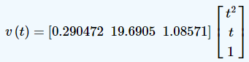
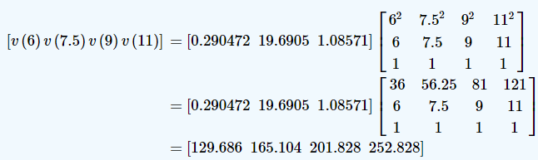
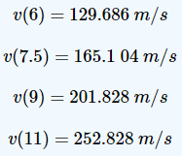
However, we could also find all the needed values of velocity at t = 6,7.5,9,11 seconds using matrix multiplication.
So, if we want to find v(6),v(7.5),v(9),v(11),v(6),v(7.5),v(9),v(11), it is given by

Slide 83
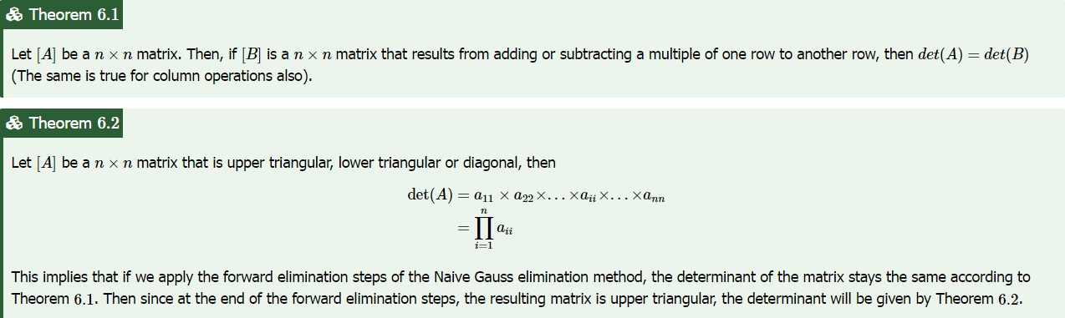
Can we use Naive Gauss elimination methods to find the determinant of a square matrix?

Slide 84
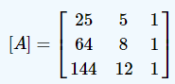
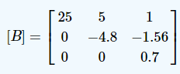
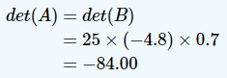
Find the determinant of
Remember in Example 1, we conducted the steps of forward elimination of unknowns using the Naive Gauss elimination method on [A] to give
According to Theorem 2

Slide 85
LU Decomposition Method
LU Decomposition is another method to solve a set of simultaneous linear equations
Which is better, Gauss Elimination or LU Decomposition?

Slide 86
LU Decomposition Method
An LU decomposition of a matrix A is the product of a lower triangular matrix and an upper triangular matrix that is equal to A.
[A] = [L][U]
where
[L] = lower triangular matrix
[U] = upper triangular matrix

Slide 87
How does LU Decomposition work?
If solving a set of linear equations
If [A] = [L][U] then
Multiply by
Which gives
Remember [L]⁻¹[L] = [I] which leads to
Now, if [I][U] = [U] then
Now, let
Which ends with
and
[A][X] = [C]
[L][U][X] = [C]
[L]⁻¹
[L]⁻¹[L][U][X] = [L]⁻¹[C]
[I][U][X] = [L]⁻¹[C]
[U][X] = [L]⁻¹[C]
[L]⁻¹[C]=[Z]
[L][Z] = [C] (1)
[U][X] = [Z] (2)

Slide 88
LU Decomposition using Crout's method of Matrix

Slide 89
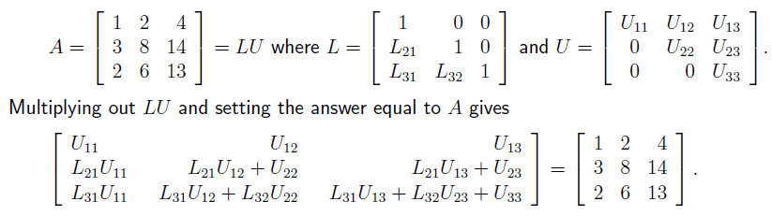
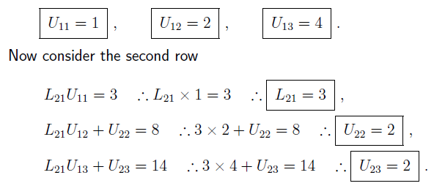
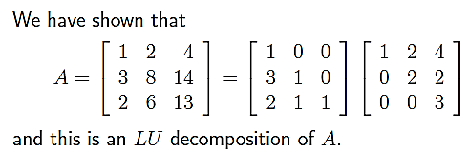
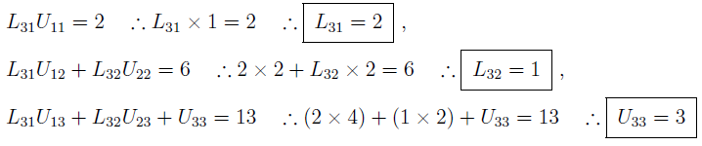

Slide 90
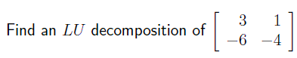


Slide 91



Slide 92
Using LU decomposition to solve systems of equations
Once a matrix A has been decomposed into lower and upper triangular parts it is possible to obtain the solution to AX = B in a direct way. The procedure can be summarized as follows
• Given A, find L and U so that A = LU. Hence LUX = B.
• Let Y = UX so that LY = B. Solve this triangular system for Y .
• Finally solve the triangular system UX = Y for X.
The benefit of this approach is that we only ever need to solve triangular systems. The cost is that we have to solve two of them.

Slide 93


Solution:

Slide 94


Slide 95



Solve

Slide 96



Do matrices always have an LU decomposition?
No. Sometimes it is impossible to write a matrix in the form “lower triangular”×“upper triangular”.
Why not?
An invertible matrix A has an LU decomposition provided that all its leading submatrices have non-zero determinants. The k^{th} leading submatrix of A is denoted A^{k} and is the k ×k matrix found by looking only at the top k rows and leftmost k columns. For example if
The fact that this matrix A has an LU decomposition can be guaranteed in advance because none
of these determinants is zero.

Slide 97


Do matrices always have an LU decomposition?

Slide 98


(a)
(b)

Slide 99


Can we get around this problem?
Yes. It is always possible to re-order the rows of an invertible matrix so that all of the submatrices have non-zero determinants.

Slide 100



Slide 101





LU decomposition using Gauss Elimination method
Solution:
L is just made up of the multipliers we used in Gaussian elimination with 1s on the diagonal.

Slide 102





LU decomposition using Gauss Elimination method
Solution:
L is just made up of the multipliers we used in Gaussian elimination with 1s on the diagonal.

Slide 103



LU decomposition using Gauss Elimination method
Solution:
L is just made up of the multipliers we used in Gaussian elimination with 1s on the diagonal.

Slide 104

Solution:?????

Slide 105





Solve the following system of equations using LU Decomposition ( LU decomosition using GE ) method:

Slide 106
Finding the inverse of a square matrix
The inverse [B] of a square matrix [A] is defined as
[A][B] = [I] = [B][A]

Slide 107
Finding the inverse of a square matrix using LU Decomposition
How can LU Decomposition be used to find the inverse?
Assume the first column of [B] to be [b₁₁ b₁₂ … b_{n1}]^{T}
Using this and the definition of matrix multiplication
First column of [B] Second column of [B]
The remaining columns in [B] can be found in the same manner

Slide 108
Example: Inverse of a Matrix
Find the inverse of a square matrix [A]
Given [A][X] = [C]
Decompose [A] into [L] and [U]
[L][U][X]=[C]
Solve [L][Z] = [C] for [Z] ([Z]=[U][X])
Solve [U][X] = [Z] for [X]
Using the decomposition procedure, the [L] and [U] matrices are found to be

Slide 109
Example: Inverse of a Matrix (cont.)
Solving for the each column of [B] requires two steps
Solve [L] [Z] = [C] for [Z]
Solve [U] [X] = [Z] for [X]
Step 1:
This generates the equations:

Slide 110
Example: Inverse of a Matrix (cont.)
Solving for [Z]

Slide 111
Example: Inverse of a Matrix (cont.)
Solving [U][X] = [Z] for [X]

Slide 112
Example: Inverse of a Matrix (cont.)
Using Backward Substitution
So the first column of the inverse of [A] is:

Slide 113
Example: Inverse of a Matrix (cont.)
Repeating for the second and third columns of the inverse
Second Column Third Column

Slide 114
Example: Inverse of a Matrix (cont.)
The inverse of [A] is
To check your work do the following operation
[A][A]⁻¹ = [I] = [A]⁻¹[A]

Slide 115


Inverse of Matrix using CROUT’S METHOD
Two-step procedure to find the inverse of a matrix A:
Step 1. Find the LU decomposition A = LU
Step 2. Find the inverse of A⁻¹ = U ⁻¹L ⁻¹ by inverting the matrices U and L.
EXAMPLE FOR FINDING INVERSE OF A MATRIX BY CROUT’S METHOD.
Find the inverse of the matrix A by using crout’s method where
$$A=\left[\begin{matrix}1 & −2 & 3 \\ 0 & −1 & 4 \\ −2 & 2 & 0\end{matrix}\right]$$
$$L=\left[\begin{matrix}1 & 0 & 0 \\ 0 & −1 & 0 \\ −2 & −2 & −2\end{matrix}\right],U=\left[\begin{matrix}1 & −2 & 3 \\ 0 & 1 & −4 \\ 0 & 0 & 1\end{matrix}\right]$$

Slide 116


To find L⁻¹ , LL⁻¹ = I. Therefore

Slide 117

Inversion Of A Matrix -Gauss Elimination Method
Consider a non singular matrix A of order 3.If X is the inverse of A then AX=I, where I is the unit matrix of order 3.Let

Slide 118



From equations (1),(2)and (3), we can solve for the vectors
using Gauss elimination method. The solution set of each systems (1),(2),(3) will be the corresponding column of the inverse matrix X.
Now the system (1) is equivalent to AX=B, where
Now our aim is to reduce the augmented matrix (A:B) to an upper triangular matrix

Slide 119


Slide 120


Slide 121


Slide 122



Slide 123





Find inverse using guass elimination method

Slide 124
LU vs GE
If you are solving a set of simultaneous linear equations, LU Decomposition method (involving forward elimination, forward substitution and back substitution) would use more computational time than Gaussian elimination (involving forward elimination and back substitution, but NO forward substitution).

Slide 125
Why use LU Decomposition?
Because, LU Decomposition is computationally more efficient than Gaussian elimination when we are solving several sets of equations with the same coefficient matrix but different right hand sides.
When you are finding the inverse of a matrix [A]. If one is trying to find the inverse of nxn matrix, then it implies that one needs to solve n sets of simultaneous linear equations of [A][X]=[C] form with the n right hand sides [C] being the n columns of the nxn identity matrix, while the coefficient matrix [A] stays the same.

Slide 126

Why use LU Decomposition?
The computational time taken for solving a single set of n simultaneous linear equations is as follows:
So for LU decomposition method used to find the inverse of a matrix, the computational time is proportional to
The forward elimination only needs to be done only once on [A] to generate the L and U matrices for the LU decomposition method. However the forward and back substitution need to be done n times.

Slide 127
Why use LU Decomposition?
Now for Gaussian Elimination used to find the inverse of a matrix, the computational time is proportional to
Remember that both the forward elimination and back substitution need to be done n times.
Hence for large n, for LU Decomposition, the computational time is proportional to , while for Gaussian Elimination, the computational time is proportional to . So for large n, the ratio of the computational time for Gaussian elimination to computational for LU Decomposition is
As an example, to find the inverse of a 2000×2000 coefficient matrix by Gaussian Elimination would take n/4=2000/4=500 times the time it would take to find the inverse by LU Decomposition.

Slide 128
Cramer’s Rule
Cramer’s rule is one of the important methods applied to solve a system of equations. In this method, the values of the variables in the system are to be calculated using the determinants of matrices. Thus, Cramer’s rule is also known as the determinant method.

Slide 129
Cramer’s Rule Formula
Consider a system of linear equations with n variables x₁, x₂, x₃, …, xn written in the matrix form AX = B.
Here,
A = Coefficient matrix (must be a square matrix)
X = Column matrix with variables
B = Column matrix with the constants (which are on the right side of the equations)
Now, we have to find the determinants as:
D = |A|, Dx₁, Dx₂, Dx₃,…, Dx_{n}
Here, Dx_{i} for i = 1, 2, 3,…, n is the same determinant as D such that the column is replaced with B.
Thus,
x₁ = Dx₁/D; x₂ = Dx₂/D; x₃ = Dx₃/D; ….; x_{n} = Dx_{n}/D {where D is not equal to 0}

Slide 130

Cramer’s Rule 2×2
Cramer’s rule for the 2×2 matrix is applied to solve the system of equations in two variables.
Let us consider two linear equations in two variables.
a₁x + b₁y = c₁
a₂x + b₂y = c₂
Let us write these two equations in the form of AX = B.

Slide 131


Cramer’s Rule Example
Solve the following system of equations using Cramer’s rule:
2x – y = 5
x + y = 4
Solution:
Given, 2x – y = 5, x + y = 4
Let us write these equations in the form AX = B.
So, the given system of equations has a unique solution.

Slide 132



Slide 133




Cramer’s Rule 3×3
To find the Cramer’s rule formula for a 3×3 matrix, we need to consider the system of 3 equations with three variables.
Consider:
Therefore, x = D_{x}/D, y = D_{y}/D, z = D_{z}/D; D ≠ 0

Slide 134

Cramer’s Rule Example – 3×3
Solve the following system of equations using Cramer’s rule:
x + y + z =6
y + 3z = 11
x + z =2y or x – 2y + z = 0
Solution:

Slide 135


Slide 136
Cramer’s Rule for a System with Two Variables
Use Cramer’s Rule to solve the system.

Slide 137
Cramer’s Rule for a System with Two Variables
For this system, we have:

Slide 138
Cramer’s Rule for a System with Two Variables
The solution is:

Slide 139
Cramer’s Rule for a System of Three Variables
Use Cramer’s Rule to solve the system.
First, we evaluate the determinants that appear in Cramer’s Rule.

Slide 140
Cramer’s Rule for a System of Three Variables
Note that D is the coefficient matrix and that D_{x}, D_{y}, and D_{z} are obtained by replacing the first, second, and third columns of D by the constant terms.

Slide 141
Cramer’s Rule for a System of Three Variables
Now, we use Cramer’s Rule to get the solution:

Slide 142
Cramer’s Rule
Solving the system in previous example using Gaussian elimination would involve matrices whose elements are fractions with fairly large denominators.
Thus, in cases like previous two exmples , Cramer’s Rule gives us an efficient way to solve systems of linear equations.

Slide 143
Limitations of Cramer’s Rule
However, in systems with more than three equations, evaluating the various determinants involved is usually a long and tedious task.
This is unless you are using a graphing calculator.

Slide 144
Limitations of Cramer’s Rule
Moreover, the rule doesn’t apply if | D | = 0 or if D is not a square matrix.
So, Cramer’s Rule is a useful alternative to Gaussian elimination—but only in some situations.

Slide 145
Cramer’s Rule Questions
Solve the following system of equations by Cramer’s rule:2x – 3y + 5z = 113x + 2y – 4z = – 5x + y – 2z = – 3
Solve the following system of linear equations using Cramer’s rule:5x + 7y = -24x + 6y = -3
The cost of 4 kg onion, 3 kg wheat and 2 kg rice is Rs 60. The cost of 2 kg onion, 4 kg wheat and 6 kg rice is Rs 90. The cost of 6 kg onion 2 kg wheat, and 3 kg rice is Rs 70. Find the cost of each item per kg by Cramer’s rule.

Slide 146
References
http://mathforcollege.com/ma/ppts/index.html
https://tinyurl.com/4dfajf5d
https://tinyurl.com/3v4t6ya8
https://pages.cs.wisc.edu/~cs310-1/modules/Numeric%20Computation/Linear%20Systems/Naive%20Gaussian%20elimination/TopicDiscussion.html

